Slide 1
Tips for Academic and Personal Success
Dr. Carl J. Wenning
Physics Department
Illinois State University
Normal, Illinois USA

Slide 2
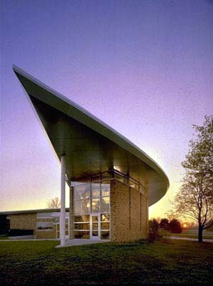
Two Approaches
Academic Success:
S = A_{i}A_{l}ME₁E₂
Behaviors and their relationship to grades
Personal Success:
Achievement and goals
Studying, learning, and time management
Professional and personal development
Personal and professional integrity

Slide 3
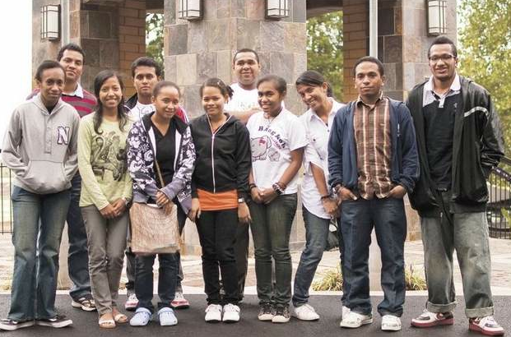
The SAAMEE Method
S = A_{i}A_{l}ME₁E₂
S = success (academic)
A_{i} = innate ability
A_{l} = learned ability
M = motivation
E₁ = effort
E₂ = environment

Slide 4
Sample Behaviors and Grades
The “A” Student:
Either innately gifted or works very hard
Highly motivated and puts forth great effort
Has a good study environment and uses tips and tricks mentioned earlier.
The “C” Student:
Possibly gifted but doesn’t work hard
Unmotivated and unwilling to work
Lacks a good study environment and fails to take advantage of the experiences of other.

Slide 5
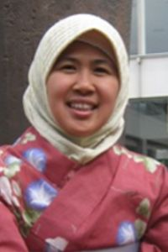
Personal Success (1)
Achievement and goals:
Set high standards for yourself
Remember that grades count
Turn in only your best work
Understand that a good education requires work
Don’t sacrifice long-term success for short-term gain
Speak with you instructor if you have difficulties
Seek out special opportunities
Honesty is the best policy
See advice before making important decisions

Slide 6
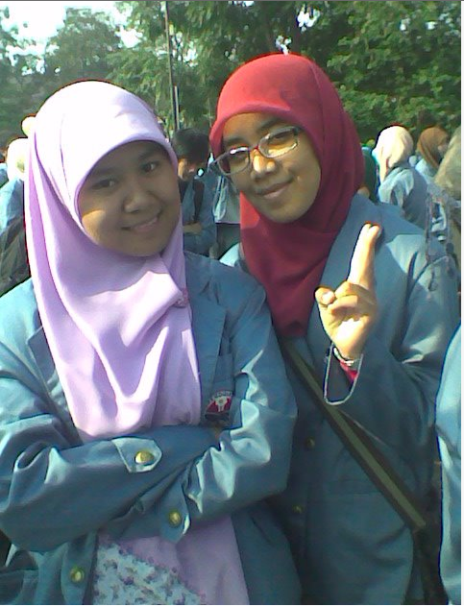
Personal Success (2)
Studying, learning, and time management:
Know what it takes to succeed
Strive to understand
Avoid procrastination
Make and use lists
Use the snowball method
Persist until the very end
Don’t ignore personal problems
Investigate learning and test-taking skills
Break your large tasks down into small units

Slide 7
Personal Success (3)
Professional development:
Seek to improve your science content knowledge every day
Take responsibility for your own actions
Get to know a wide range of people – faculty, staff, and students
Choose your friends carefully
Express your appreciation
Remember that integrity counts

Slide 8
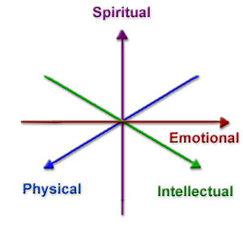
Personal Success (4)
Personal and professional integrity:
Form strong personal and professional relationships
Learn from the successes and failures of others
Letters of recommendation
Never forget yourself…

Slide 9
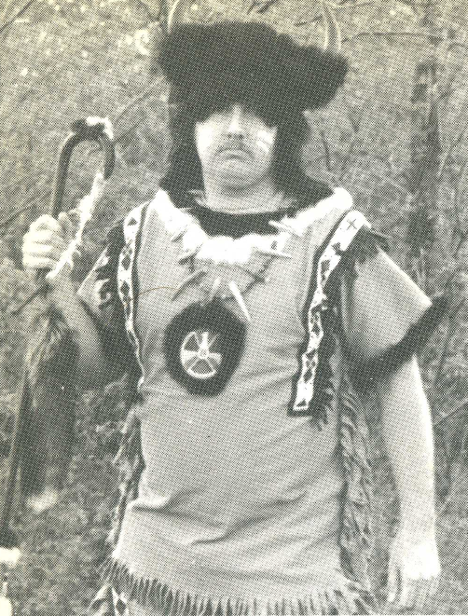
Closing Thoughts
The best students are not always the best teachers
The story of Donald J.
The story of Jason R.
The story of Carl W.
The best teachers are those who…
care about students
understand students
educate the whole student
Education at UPI:
Physics teaching program
Physics teacher educators
Physics teaching majors
High school students

Slide 10
Thank you Mr. Arif Hidayat!

Slide 11
ABCs of Success
Advice for physics teacher education majors
http://www.phy.ilstu.edu/pte/advice.html
Behavior and it’s relationship to course grades
http://www.phy.ilstu.edu/pte/SAAMEE.pdf
Changing perspectives: Student to teacher
http://www.phy.ilstu.edu/pte/310content/perspective.html

